Slide 1
Training for Effective Mentees
Workshop 1: Getting Prepared
Mentorship program name
Facilitator name
Presentation date

Slide 2
Welcome!
Training facilitator | Program manager
Name Title Organization Email | Name Title Organization Email

Slide 3
We respect and acknowledge Indigenous Peoples (First Nations, Inuit and Métis) as the Keepers of the Territory ​upon which we’ll be learning today.

Slide 4
Training for Effective Mentees
Rationale
To develop effective mentees, participants must understand their role as the driver of their mentorship experience
Objective
To provide mentees with the connections, knowledge and tools to use throughout their experience in the mentorship program
Process
Combine small-group activities, large-group discussions, and homework to be completed individually and with a mentor

Slide 5
Overview: Training for Effective Mentees
Date Time | Workshop 1: Getting Prepared
 | Learn about the mentorship program Meet the program participants Debrief the activities: Mentee preparation and self-assessments
Preparation break: Complete preparation activities and connect with mentor
Date Time | Workshop 2: Setting the Stage
 | Discuss the role of the mentee and how to be effective Debrief the homework: Mentorship quiz and expectations for the program Complete the activity: Networking exercise
Preparation break: Complete preparation activities and connect with mentor
Date Time | Workshop 3: Developing Together
 | Debrief the homework: Discussing conflict or challenges with your mentor Complete the activity: Facilitating reflection Discuss your experience in the program so far

Slide 6
Mentorship program overview

Slide 7
Mentorship program overview
Rationale
To be an effective mentee, it’s essential to understand the mentorship program and the expectations of the mentee’s role
Objective
To introduce the program participants to the core elements of the mentorship program
Process
Combine information with a debrief for questions

Slide 8
About the mentorship program
Provide a program description here
Program goal
Describe program goal
Program objectives
Objective 1
Objective 2
Objective 3
Objective 4

Slide 9
Program activities
The mentorship program includes the following activities:
Program activity 1 (for example, 1-on-1 mentoring)
Description
Program activity 2 (for example, formal learning)
Description
Program activity 3 (for example, informal learning)
Description

Slide 10
Program schedule
Activity | Date
Activity | Date
Activity | Date
Activity | Date
Activity | Date
Activity | Date
Activity | Date
Activity | Date
Activity | Date
Activity | Date
Activity | Date
Activity | Date
* Not mandatory

Slide 11
Program resources
Learning resources
A Mentorship Guide for Advancing Women in Coaching: Effective Mentoring Practices for the Mentee (also called the Mentee Guide)
Training for Effective Mentees: Mentee Workbook (also called the Mentee Workbook)
Technology requirements
Software 1 (for example, Microsoft Teams, Zoom)
Software 2 (for example, Slack, WhatsApp)

Slide 12




Slide 13
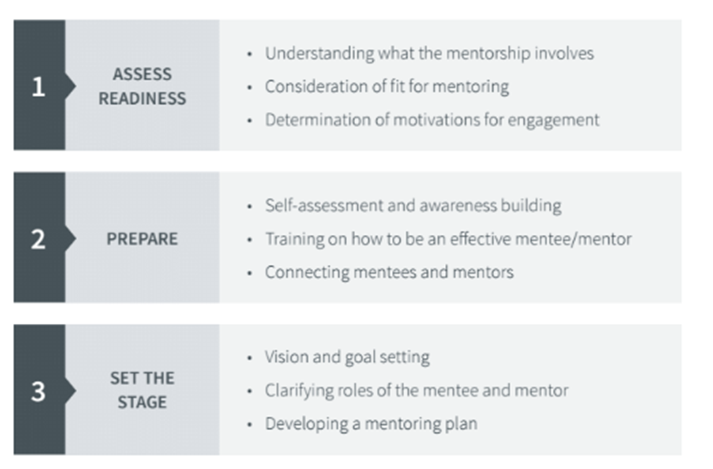
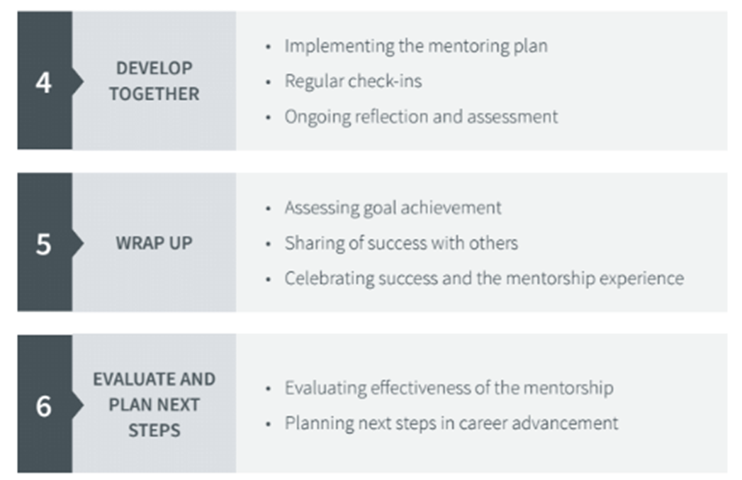
Stages of mentorship

Slide 14
Questions?

Slide 15
Introductions

Slide 16
Introductions
Rationale
Developing connections with the other program participants can support a positive mentorship experience
Objective
To introduce the program participants to each other
Process
Roundtable introductions

Slide 17
Program mentors
Name | Sport

Slide 18
Program mentees
Name | Sport
Name | Sport

Slide 19
Debrief

Slide 20
Debrief
Rationale
Learn more about yourself and others by discussing:
  your motivations to be a mentee or mentor
  your coaching philosophy
Objective
To discuss the homework activities with the other program participants
Process
Small-group activities

Slide 21
Breakout room 1: Getting ready for your role
In the breakout rooms, you’ll be separated into groups based on your role (mentee or mentor).
Mentees will discuss the following activities from the Mentee Workbook:
Activity: The decision to be a mentee (section 1.2)
Activity: Mentee motivation scale (section 1.3)
Mentors will discuss the following activities from the Mentor Guide:
The decision to be a mentor (page 20)
Mentor motivation scale (page 21)

Slide 22
Breakout room 2: Self-assessment
In the breakout rooms, you’ll be separated into new groups, with both mentees and mentors.
Mentees will discuss the following activities from the Mentee Workbook:
Self-assessment tool (section 1.4)
My coaching philosophy (section 1.5)
Mentors will discuss the following activities from the Mentor Guide:
Self-assessment and awareness building (page 23)
My coaching philosophy (page 24)

Slide 23
Next steps

Slide 24
Before Workshop 2: Setting the Stage
Connect with your mentor coach and reflect on the workshop and activities
Read pages 25 to 40 of the Mentee Guide
On your own, complete the following activities in the Mentee Workbook:
  The coach I want to be (section 2.2)
With your mentor, complete the following activities in the Mentee Workbook:
  Questions to ask after being paired with a mentor (section 2.3)
  Mentorship quiz (section 2.4)
  Developing a vision (section 2.5)
  Goal-setting exercises (section 2.6)
  Creating a mentorship plan (section 2.7)

Slide 25
Questions?
Training facilitator | Program manager
Name Title Organization Email | Name Title Organization Email

Slide 26
Thank you!

Slide 27
Training for Effective Mentees
Workshop 2: Setting the stage
Mentorship program name
Facilitator name
Presentation date

Slide 28
Welcome!
Training facilitator | Program manager
Name Title Organization Email | Name Title Organization Email

Slide 29
We respect and acknowledge Indigenous Peoples (First Nations, Inuit and Métis) as the Keepers of the Territory ​upon which we’ll be learning today.

Slide 30
Training for Effective Mentees: Setting the stage
Workshop agenda
Discuss the mentee’s role and how to be effective
Debrief the homework (mentorship quiz and expectations for the program)
Complete the activity (networking exercise)
Rationale
To develop effective mentees, participants must understand their role as the driver of their mentorship experience
Objective
To provide mentees with the connections, knowledge and tools they’ll use throughout their mentorship program

Slide 31
Discuss

Slide 32
Discuss the mentee’s role and how to be effective
Rationale
Mentees must understand the timeline of a mentorship program and their role and responsibilities throughout it
Objective
To provide mentees with the understanding, skills and strategies necessary to be an effective mentee
Process
Large-group discussions

Slide 33
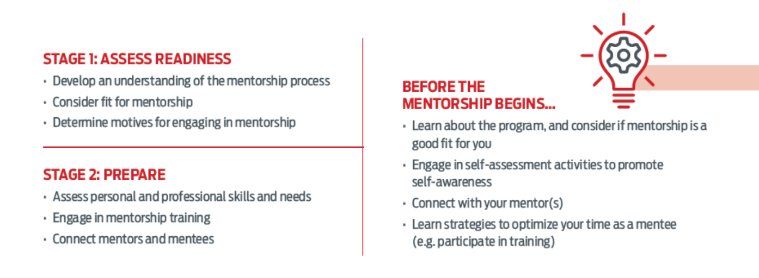
Mentee’s roles and responsibilities

Slide 34
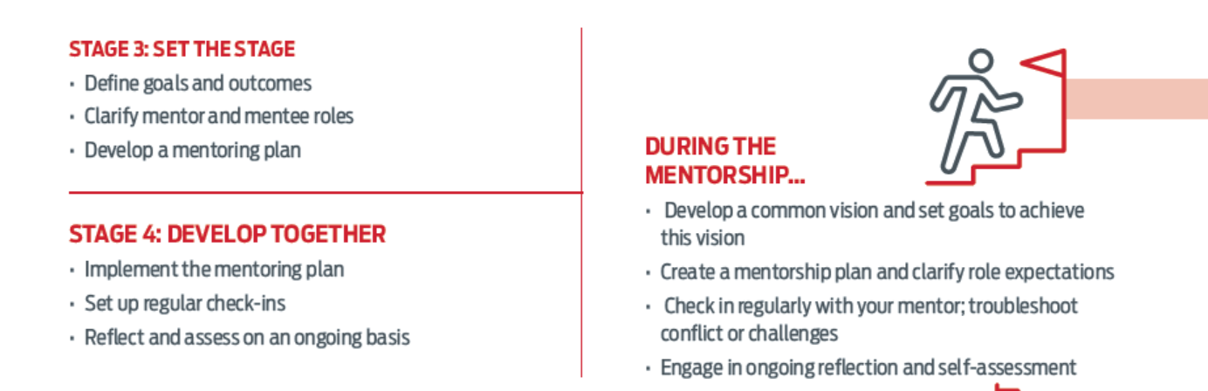
Mentee’s roles and responsibilities (continued)

Slide 35
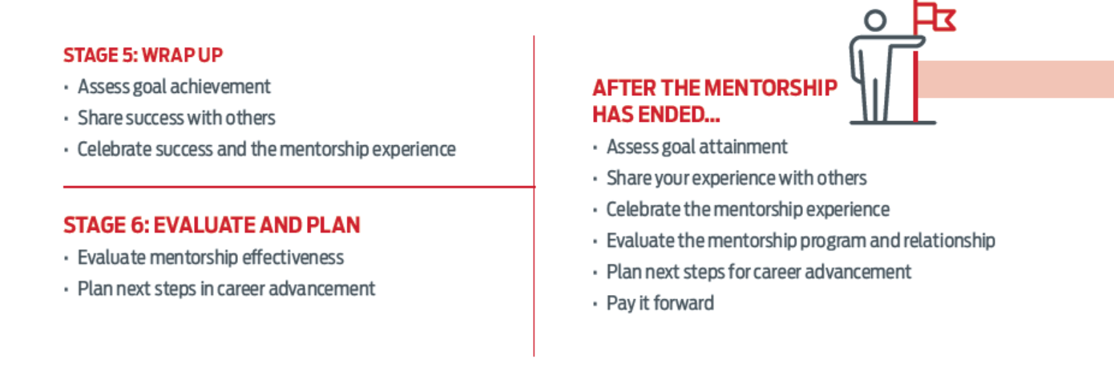
Mentee’s roles and responsibilities (continued)

Slide 36
Strategies to be an effective mentee
Important mentee skills include:
Effective communication
Active listening
Taking an active part in the mentorship relationship
A willingness to try new things
Accepting feedback effectively
Discussion:
Are there any other skills or strategies you would add to this list?
Mentee Guide, page 29

Slide 37
Making the most of the mentorship
Receiving feedback | Understand current strengths Understand opportunities for future development Open new doors to career advancement
Initiating conversation | Seek opportunities to learn from your mentor’s experience (example: ask your mentor about the barriers they’ve faced as a coach)
Going outside your comfort zone | Challenge yourself to grow personally and proactively (examples: share new ideas with your mentor and others, seek advice when presented with challenges, accept completed challenges and more important responsibilities)
Networking and professionalism | Make a positive first impression with a positive attitude (examples: friendliness, humility, willingness to learn, adaptability, consideration and gratitude) Follow the first impression with consistency, reliability and commitment to your mentorship experience
Mentee Guide, pages 44 to 47

Slide 38
Debrief

Slide 39
Debrief the homework: Mentorship quiz and expectations for the program
Rationale
Mentees need to compare their expectations of a mentorship program to their mentors’ expectations to ensure they’re similar
Objective
To discuss the expectations of a mentorship program and learn from the experiences of others
Process
Small-group discussions and a large-group debrief

Slide 40
Debrief: Mentorship quiz
In your breakout room, reflect on your expectations for the program. Go to section 2.4 of the Mentee Workbook,
Activity: Mentorship quiz.
Did you learn anything about mentorship and your expectations from this activity?
Were there any conflicting expectations?
You can also discuss any key points or interesting thoughts based on your reading of the Mentee Guide.
After the breakout sessions end, we’ll have a group debrief in the main room. Please select a group member to share your conversation highlights.

Slide 41
Complete

Slide 42
Complete the activity: Networking exercise
Rationale
Mentorship programs provide the opportunity for mentees to build connections both within and outside of the program
Objective
To get to know the other mentees and their experiences in coaching, while building a list of contacts and career opportunities
Process
Small-group discussions and a large-group debrief

Slide 43
Complete: Networking exercise
In the breakout rooms, complete Activity: Networking exercise in section 2.8 of your Mentee Workbook.
After the breakout sessions end, we’ll have a group debrief in the main room. Please select a group member to share your conversation highlights.

Slide 44
Next steps

Slide 45
Before Workshop 3: Developing Together
Read pages 41 to 64 in the Mentee Guide
Connect with your mentor coach and reflect on the workshop and activities
  Review pages 46 and 47 in the Mentee Guide
  Review and add to Activity: Networking exercise, section 2.8 in the Mentee Workbook
With your mentor, complete the following activities in the Mentee Workbook:
  Barriers and facilitators (section 3.2)
  Discussing conflict or challenges with your mentor (section 3.3)

Slide 46
Questions?
Training facilitator | Program manager
Name Title Organization Email | Name Title Organization Email

Slide 47
Thank you!

Slide 48
Training For Effective Mentees
Workshop 3: Developing together
Mentorship program name
Facilitator name
Presentation date

Slide 49
Welcome!
Training facilitator | Program manager
Name Title Organization Email | Name Title Organization Email

Slide 50
We respect and acknowledge Indigenous Peoples (First Nations, Inuit and Métis) as the Keepers of the Territory ​upon which we’ll be learning today.

Slide 51
Training for Effective Mentees
Workshop agenda
Debrief the homework: Discussing conflict or challenges with your mentor
Complete the activity: Facilitating reflection
Discuss your experience in the program so far
Rationale
To develop effective mentees, participants must understand their role as the driver of their mentorship experience
Objective
To provide mentees with the connections, knowledge and tools to be used throughout the duration of their experience in the mentorship program

Slide 52
Debrief

Slide 53
Debrief the homework: Discussing conflict or challenges with your mentor
Rationale
Mentorship programs provide a safe place for mentees to understand and practice how to manage conflict and challenges
Objective
To identify strategies and resources to help address conflict, both within and outside of a mentorship program
Process
Small-group discussions and a large-group debrief

Slide 54
Debrief: Discussing conflict or challenges with your mentor
In your breakout room, reflect on your experiences with conflict. Go to the activity in section 3.3 of the Mentee Workbook, Discussing conflict or challenges with your mentor.
Question to consider:
Do you feel confident in your ability to address conflict if it arises?
What conflict management resources have been helpful to you?
Could this resource be applied to conflict with others? Coaches, parents or guardians, athletes or participants?
After our breakout sessions end, we’ll have a group debrief in the main room. Please select a group member to share your group’s conversation highlights.

Slide 55
Complete

Slide 56
Complete the activity: Facilitating reflection
Rationale
Mentorship programs provide the opportunity for mentees to set goals and then practise reflection on their goal achievement and overall experience
Objective
To understand how tools can be used to facilitate reflection
Process
Small-group discussions and a large-group debrief

Slide 57
Complete: Facilitating reflection
In the breakout rooms, complete Activity: Facilitating reflection in your Mentee Workbook in section 3.4.
Each room will be assigned a reflection model to try out. Review that model to reflect on an experience in the program or during your coaching career. Write down your key reflections and share in your group.
After the breakout sessions end, we’ll have a group debrief in the main room. Please select a group member to share your conversation highlights and explain how the model helped to facilitate your reflection.

Slide 58
Discuss

Slide 59
Discuss your experience in the program so far
Rationale
By reflecting on their experience, mentees are practicing the skill of reflection and can provide feedback on the program
Objective
To reflect on the knowledge obtained throughout the mentorship experience so far and provide suggestions to enhance the program
Process
Large-group debrief

Slide 60
Group discussion
Do you feel effective in your role as a mentee?
What have you learned about yourself since starting the program?
Is the program meeting your expectations?
What professional development topics would you like to learn more about during the program?

Slide 61
Next steps

Slide 62
Next steps
Connect with your mentor coach and reflect on this workshop and the activities
Facilitator or program manager to follow up occasionally throughout the program
Continued connection:
  Example
  Example
  Example

Slide 63
Thank you!

